Slide 1
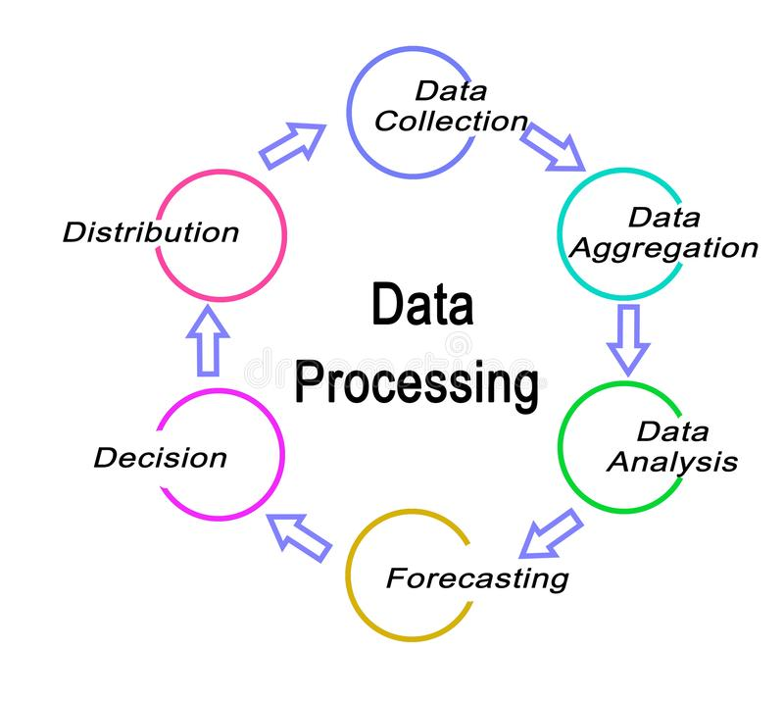
DATA PROCESSING

Slide 2
What is data processing?
Data processing occurs when data is collected and translated into usable information. Usually performed by a data scientist or team of data scientists, it is important for data processing to be done correctly as not to negatively affect the end product, or data output.
Data processing starts with data in its raw form and converts it into a more readable format (graphs, documents, etc.), giving it the form and context necessary to be interpreted by computers and utilized by employees throughout an organization.

Slide 3
The future of data processing
The future of data processing lies in the cloud. Cloud technology builds on the convenience of current electronic data processing methods and accelerates its speed and effectiveness. Faster, higher-quality data means more data for each organization to utilize and more valuable insights to extract.
As big data migrates to the cloud, companies are realizing huge benefits. Big data cloud technologies allow for companies to combine all of their platforms into one easily-adaptable system. As software changes and updates (as it does often in the world of big data), cloud technology seamlessly integrates the new with the old.
The benefits of cloud data processing are in no way limited to large corporations. In fact, small companies can reap major benefits of their own. Cloud platforms can be inexpensive and offer the flexibility to grow and expand capabilities as the company grows. It gives companies the ability to scale without a hefty price tag.

Slide 4
SIX STAGES OF DATA PROCESSING
1. Data collection: Collecting data is the first step in data processing. Data is pulled from available sources, including data lakes and data warehouses. It is important that the data sources available are trustworthy and well-built so the data collected is of the highest possible quality.
2. Data preparation: Once the data is collected, it then enters the data preparation stage. Data preparation, often referred to as “pre-processing” is the stage at which raw data is cleaned up and organized for the following stage of data processing. During preparation, raw data is diligently checked for any errors.
3. Data input: The clean data is then entered into its destination , and translated into a language that it can understand. Data input is the first stage in which raw data begins to take the form of usable information.
4. Processing: During this stage, the data inputted to the computer in the previous stage is actually processed for interpretation. Processing is done using machine learning algorithms, though the process itself may vary slightly depending on the source of data being processed .
5. Data output/interpretation: The output/interpretation stage is the stage at which data is finally usable to non-data scientists. It is translated, readable, and often in the form of graphs, videos, images, plain text, etc. Members of the company or institution can now begin to self-serve the data for their own data analytics projects.
6. Data storage: The final stage of data processing is storage. After all of the data is processed, it is then stored for future use. Plus, properly stored data is a necessity for compliance with data protection legislation like GDPR. When data is properly stored, it can be quickly and easily accessed by members of the organization when needed.

Slide 5


